Slide 1
Year 10 Transition
Into Your
2023 Year 11 Program
STRIVING FOR EXCELLENCE

Slide 2
Senior School Team
Introduction to relevant staff
  Mr Brad Moyle - Principal
  Ms Annette Spence /Mr Joshua Wolter– Assistant Principals
  Ms Melissa Foresio – Senior School Leading Teacher Student Achievement
  Mr Dean Malcolm – Senior School Leading Teacher Careers and Programs
  Ms Giovanna Hill– Applied Learning Coordinator
  Ms Natalie Guarino–VET

Slide 3
Purpose of this PPT
Advice on how to use the Project and subject selection program
Information on the different programs at Epping SC
Important dates

Slide 4
Achieving Your Outcome
What are you hoping to get out of senior secondary school?
  Be work ready?
  Obtain an apprenticeship?
  Particular ATAR?
  University
  Particular Certificate? Eg Cert II in Plumbing

Slide 5
We know that successful students will:
attend every day
set aside the appropriate time to study
push themselves and do their very best to achieve the outcome they want
work hard in classes and ask for support when it is needed
be excellent role models for the rest of the school

Slide 6
Optimising Your Opportunities
Be honest with yourself about your abilities
  Do not forget the growth mindset
Be sensible and smart about your choices
  Pick the program that helps you achieve your goal
Select subjects you are good at or that you like and that you have shown an aptitude for
  Not what your friends are doing
  Not everyone should be a doctor
Be willing to sacrifice some of your social, sporting, work and home life activities
  School is an investment in your future

Slide 7
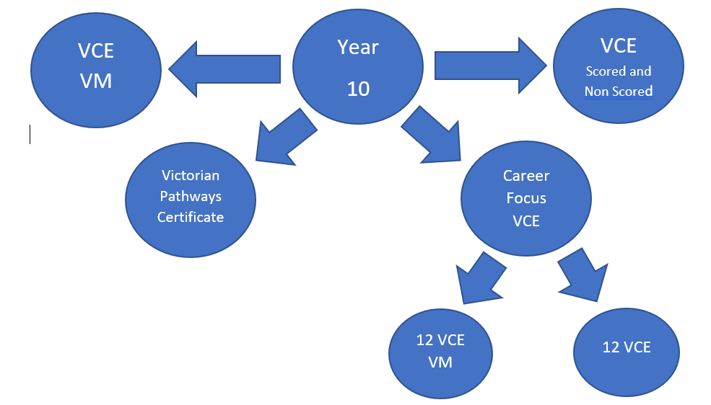
Choosing a Program
Which program will get me to my chosen
  Career / job
  Apprenticeship / Traineeship
  University / TAFE
Which subjects are needed as part of this program?
  Which Mathematics? – Do I need Maths?
  Which VET course? - Purpose & Cost are factors

Slide 8
Choosing a Program
VCE VM
I am thinking that when I leave school I might want to focus on a traineeship, apprenticeship or further studies.
I would prefer to do this in a more “Hands On” way.
VPC
I am struggling academically at the year 10 level and am looking to develop personal learning & life skills at year 11.
Career Focus VCE
I like the option of VCE, but also want to leave my options open to a career path that may include a traineeship, apprenticeship or further studies.
VCE
The career path I am keen to follow requires entry into university.
I prefer the academic focused subjects listed in this booklet.

Slide 9
Victorian Certificate of Education
All ESC VCE policies & guidelines are set in accordance with the regulations outlined by the Victorian Curriculum & Assessment Authority (VCAA)
Ms Annette Spence
VCE
‘Striving for excellence’

Slide 10
Why Epping Secondary College?
Striving for Excellence culture
VCE Excellence Team
VCE Results
VCE Study Support Programs
VCE Teachers with VCAA Examination marking experience
Leadership programs
Acceleration opportunities

Slide 11
VCE Program
The VCE is a two year program covering Years 11 and 12.
Subjects are divided into Units:
        Each Unit takes one semester
        Unit 1 and 2 (Year 11)
        Unit 3 and 4 (Year 12)
Year 11 students do 6 subjects.
Year 12 students do 5 subjects.

Slide 12
VCE
To qualify for the VCE students must complete:
  16 units in total (out of 22) over the two years.
  At least 3 units of English (with two as part of a
  Unit 3 / 4 sequence)
  At least 3 other Year 12 subjects (these must be done as part of a Unit 3 / 4 sequence).
*NOTE: Each Unit comprises 2 to 4 Outcomes
Notes:
English only one compulsory.
Must check course for maths

Slide 13
VCE
VCE Language:
  No longer say ‘pass’ or ‘fail’
  Satisfactorily complete the Unit / Outcome ‘S’
  Unsatisfactorily complete the Unit / Outcome ‘N’
Satisfactory completion of units:
  Students will receive an ‘S’ or ‘N’ for each unit depending on whether all outcomes have been completed to a satisfactory standard for that subject
  Outcomes are assessed in
    SACs
    SATs
  All work must be completed by due dates
  90% attendance must be maintained
  Work must be authenticated to be the student’s own

Slide 14
Student Acceleration
Epping Secondary College does offer the opportunity to undertake an accelerated subject by completing a Unit 3 and 4 (Year 12) subject during Year 11
Students interested in taking a Unit 3 and 4 subject whilst in Year 11 will need to use the criteria below to gauge likelihood of being accepted:
  Achieve results that are to a high standard in Year 10
  Meet the demands of VCE studies as indicated by their interim and semester results
  Meet the 90% attendance expectation for a VCE student
  See Mr Malcolm for application forms
  Will go through a selection process

Slide 15
Non Scored VCE
Epping Secondary College offers a non scored VCE program in year 12
Students will not sit end of year exams , but will still generate a VCE certificate
Only to be used rarely and must align with:
  Circumstances where a student’s welfare is going to be impacted
  A genuine pathway goal – TAFE or work

Slide 16

VCE Attendance Policy and Procedures
Program | Unapproved absences | Total absences
Year 11 VCE | 5 periods | 10 periods
Year 12 VCE | 5 periods | 10 periods
VCAL | 5 periods | 10 periods
VETis | 2 periods | 4 periods
Approved reasons for absence | Unapproved reasons for absence
Illness – medical certificate | Driving lessons
Funeral – notice from paper and note from home | Personal issues (without further explanation)
Job interview – letter from employer | Family commitments
Medical/dental appointments (which cannot be arranged out of class time) – medical certificate | SAC / SAT preparation or completion of work due in other subjects
Court appointments and counselling – letter from the court | Part time work commitments
College/State/National representation in sport – if outside school, letter from coach | Sleeping in or missing the bus Car or bike breakdown
License testing (one attempt only) - receipt | Supporting upset friends or timetable mix-ups
Year 12 Examinations | Centrelink appointments
 | Family holiday
 | Note from parent or guardian

Slide 17
Three Year VCE
At Epping Secondary College an option to complete VCE studies over three years is available to some students who would benefit from such a program eg
  EAL learners who need more time to develop their English literacy
  Positive Case Managed students
    Extended absences
    Not meeting VCE unit requirements

Slide 18
Post VCE
Completion of the VCE certificate can lead the student onto further study at either University or TAFE
Access to most TAFE courses is still available to Non Scored VCE students
Many University courses also have subject prerequisites that students need to be aware of – students need to check these before selecting subjects

Slide 19
Example of a VCE program:
Science – Behavioural
Year 11 | English 1 | Biology 1 | Psychology 1 | General Maths 1 | Sociology 1 | Health 1
 | English 2 | Biology 2 | Psychology 2 | General Maths 2 | Sociology 2 | Health 1
Year 12 | English 3 | Biology 3 | Psychology 3 | Further Maths 3 | Sociology 3
 | English 4 | Biology 4 | Psychology 4 | Further Maths 4 | Sociology 4
Employment |  |  | TAFE |  | Tertiary
Beauty Therapist, Teaching*, Childcare, Social Work, Nursing Psychology *May require maths |  |  | Childcare, Beauty Therapy, Community Services, Youth Work, Disability Studies, Welfare Studies, Nurse |  | Nursing, Social Work, Psychology, Education, Youth Work, Public Health, Speech Pathology

Slide 20
Victorian Certificate of Education
All ESC VCE policies & guidelines are set in accordance with the regulations outlined by the Victorian Curriculum & Assessment Authority (VCAA)
Mr Dean Malcolm
Career Focus VCE
‘Striving for excellence’

Slide 21
Career Focus program
The VCE Career Focus program is for students who are still unsure of their pathway
Are you:
Unsure whether you want to go to University, but also do not have a definite career focus at present?
Unsure of your ability to cope with the rigours of a VCE scored program. ie: Gaining an ATAR at the end of year 12?
Interested in looking at a careers option, but still want to be able to get a VCE certificate at the end of year 12?
Unsure whether VCE VM would provide you with the options you are looking for at this point in time? An example of this would be – Digital Media or Coding
Unsure of whether you want to fully commit to a VET and Structured Work Placement based on a particular career pathway?
Interested in a career type course but do not wish to reduce your “In School” learning to 3 days per week?
Interested in a program that includes workplace experiences without having to commit to a full program aimed at a particular career?
Notes:
We can offer this next year because SWL is now recognised as Units towards a VCE certificate
If you answered yes to these questions, then Career Focus VCE would suit you

Slide 22
A Sample Career Focus program
Period | Monday | Tuesday | Wednesday | Thursday | Friday
1 | English | Business Man. |  | Gen. Maths
2 | Gen. Maths | Info. Tech. | Student Selected VET | Info. Tech. | Industry & Ent.
3 | Business Man. | English |  | English | WLR - Workplace learning Record
4 | Info. Tech | Gen. Maths | EG: Electro technology | Business Man. | VCE Credit SWL
The Structured Workplace Learning (SWL) component of this program may be completed by undertaking a placement on a weekly basis (Friday) or as a block release ie: 1 week release during each term or during student holiday period.
The SWL component is an accredited option by the VCAA. Students will gain 2 units of VCE accreditation on completion of the Structured Workplace Learning and their Workplace Learning Record book.
Parent attendance at the Subject Selection Day is required before this enrolment can be confirmed.
Notes:
SWL is a mandatory part of this program – finding a workplacement is challenging, so need ot begin now. See our careers team if you are having trouble finding a placement

Slide 23
Victorian Certificate of
Education - Vocational Major
Mr Dean Malcolm
VCE VM
‘Striving for excellence’

Slide 24
VCE VM
The Victorian Certificate of Education (VCE) is Victoria’s senior secondary qualification. It opens pathways to university, higher-level TAFE or VET certificate courses, apprenticeships, traineeships and the workforce.
The VCE is expanding to include the Vocational Major, a 2-year vocational and applied learning program. It will replace Senior and Intermediate VCAL from 2023.
The VCE Vocational Major will develop your personal and practical life skills. It will help to prepare you for the next important stage of your life.

Slide 25
VCE VM
The VCE Vocational Major offers a pathway into:
apprenticeships
traineeships
further education and training
university (through alternative entry programs)
employment.
Remember that you already have many talents and you can now pursue them under the new VCE.

Slide 26
VCE VM
Students must satisfactorily complete 16 units which must include:
3 VCE VM Literacy or VCE English units (including a Unit 3–4 sequence)
2 VCE VM Numeracy or VCE Mathematics units
2 VCE VM Work Related Skills units
2 VCE VM Personal Development Skills units, and
2 VET credits at Certificate II level or above (180 nominal hours)

Slide 27
VCE VM
You must also complete at least 3 other unit 3–4 sequences. This means 3 other full year studies at a year 12 level. You can do other VCE studies or VET.
You will apply knowledge and skills in practical settings such as workplaces. You’ll do community-based activities and projects that involve working in a team. You can also receive credit for on-the-job learning.

Slide 28
VCE VM
Your teachers will assess your progress through a range of activities. You won’t receive an ATAR. This is because there are no external assessments, apart from the General Achievement Test and in some scored VCE VET programs.
Most students will finish their VCE Vocational Major over 2 years.
When you’ve completed your course, you will receive a Victorian Certificate of Education with the additional words ‘Vocational Major’.

Slide 29
Vocational Education and Training in School
Part of gaining a VCE VM Certificate involves engaging in and satisfactorily completing units of a nationally accredited training course eg.
  VETiS (Vocational Education and Training in School – eg plumbing)
  SBAT (School Based Apprenticeship and Training)
  Traineeships

Slide 30
Philosophy of VCE VM
VCE VM is underpinned by the following curriculum principles:
  Student - centred approaches
  Programs based around personal strengths
  Learning connected to the community
  Programs designed allowing students to pursue a range of pathway options
Notes:
Preparing for workplace

Slide 31
Applying for VCE VM
Year 10 students must complete a VCE VM application kit and then sit an interview before being accepted into the VCE VM program
The interview will involve both the parents and the student as the program involves a tripartisan agreement
Students will not be selected into the VCE VM program unless a clear employment and training focus is identified.

Slide 32
VETiS
Vocational Education and Training in School
Mr Dean Malcolm

Slide 33
VETiS
The VET in the VCE program combines general VCE studies with vocational training and experience in the workplace
These one or two year programs offer the chance for the student to gain two certificates within the same timeframe – VCE and VETiS Certificate level – without an increased workload

Slide 34
VETiS
Students study a total of four VCE VET units which can attract Study Scores in the same manner as VCE units
Some VET studies are nationally recognised and develop industry vocational skills in the students
The certificates can reduce the time to complete higher certificates or apprenticeships
VCE students must show VET relates to their future career before they will be accepted.

Slide 35
VETiS
VET subject areas include (but are not limited to):
  Health Laboratory Skills
  Sport and Outdoor Recreation Equine Studies
  Interactive Media Business
  Early Childhood Education Community Services
  Building and Construction Plumbing
  Hairdressing Automotive
  Music Electrotechnology
  Horticulture Administration
  Dance Engineering
  Hospitality Beauty Therapy

Slide 36
VETiS
Some of the programs are run at Epping SC
Others are run at various schools / TAFEs around the Northern area
Some may incur a minor cost.
Wednesday is usually set as the VETiS day in the Northern District (for first year courses). Second year often run on Friday.
A minimum number is required for each program to run

Slide 37
VETiS
Some VET courses will require added literacy and numeracy assessments before the school will allow the student to enrol.
Students will need to demonstrate they are capable of the added academic requirements of the more demanding course.
Many VET providers will pre-test students on their literacy and numeracy ability and the school will strongly follow their recommendations.
VET courses are an added family expense and the school needs to be confident of student success.

Slide 38
VETiS
USI Number – All students looking at doing a VET course MUST have a Unique Student Identifier (USI) number.
This can be easily accessed online using a health care card or some other form of identification
VET applications will not be accepted without a USI number
2023 VET Handbook will be available on Wednesday 22nd June from Natalie in the careers Office (or online). You will need to collect a VET handbook and application form. Instructions on how to create a USI are included. The completed VET form will need to be handed in on subject selection night.

Slide 39
What Now?
Read the Senior Years handbook
  - Soft copy sent out through Xuno and on school website
If interested in VCE VM contact the VCE team for further info and complete the VCE VM Application Kit
Review the VETiS handbook (look at what courses complement direction)
Use the Epping SC Careers Website for information on future career/tertiary options
Use your career action planner, career personality report and Morrisby report to look at your possible future direction
Attend 2023 Year 11 Camp
Use Xuno for forms and information

Slide 40
Application – VCE/CF
For those selecting either the VCE or Career Focus programs, subject selections will be made using the EDVAL CHOICE program
Students will be sent an individualised webcode to sign in with and will then complete their appropriate subject selections.
These selections need to be entered before Wednesday 2o^{th} July.
Individual subject counselling will occur for all year 10 students and parents on Wednesday 20th July. Set interview times will be offered.

Slide 41
Application – VCE VM
For those students selecting the VCE VM program they need to complete the VCE VM application kit.
This kit needs to be submitted before a program suitability interview takes place
These application kits need to be submitted before Wednesday 20th July.
VCE VM interviews will be held with parents and students at a suitable time

Slide 42
Decisions
Discuss your preferred program with your family and choose a program which suits your goals
Complete Edval Choice subject selections or VCE VM Application Kit
Endorsements for higher academic demand subjects need to be completed if necessary
Attend the July 20th course counselling interview
When attending, bring with you for the interview
  VCE VM application kit (if applicable)
  Career E Portfolio and/or Career Action Plan
  Accelerated Subject form – if applicable

Slide 43
Important Dates
Wednesday 22nd June – Parent Information Evening
  Discuss subject selections, course prerequisites and career choices with parent/guardian, career advisors and staff
Tuesday 14thJuly
  Year 10’s Acceleration for unit 3 /4 close –for students wishing to study a unit 3 / 4 with no 1 / 2 sequence
Wednesday 20th July
  Subject selection Edval Choice selections must be completed and if necessary selection interviews take place
Monday 28th November – Friday 2nd December
  Commencement of Year 11

Slide 44
Thank You for Attending
If you have any queries during term three please contact
Mr Malcolm / Ms Spence / Ms Foresio -
VCE and Career Focus VCE
Mr Malcolm / Ms Spence -
Vocational Major
Mr Malcolm / Ms Natalie Guarino- VETiS
9401 2599

