Slide 1
Year 10 Subject Selection Guide
EPPING SECONDARY COLLEGE

Slide 2
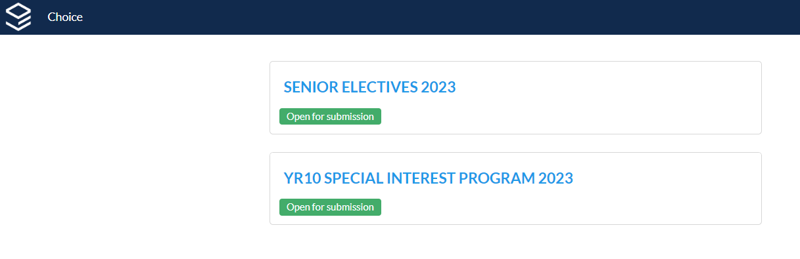
This is what the form will look like once you have logged in with your WebCode.
1) This form will be used to complete your subject selections
This form will be used to complete your SIP subject selections

Slide 3
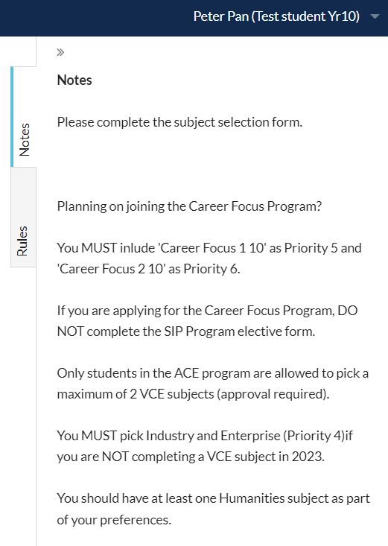
Notes: Follow the instructions.

Slide 4
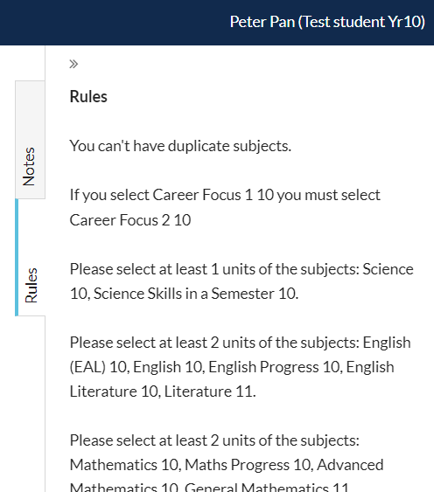
Rules: These rules apply to every student.
Any breech of these rules will result in you being unable to submit your form.
You will be prompted with what you need to do in order to fix the issue.
Once you fix the issue, you will be able to submit the form.

Slide 5
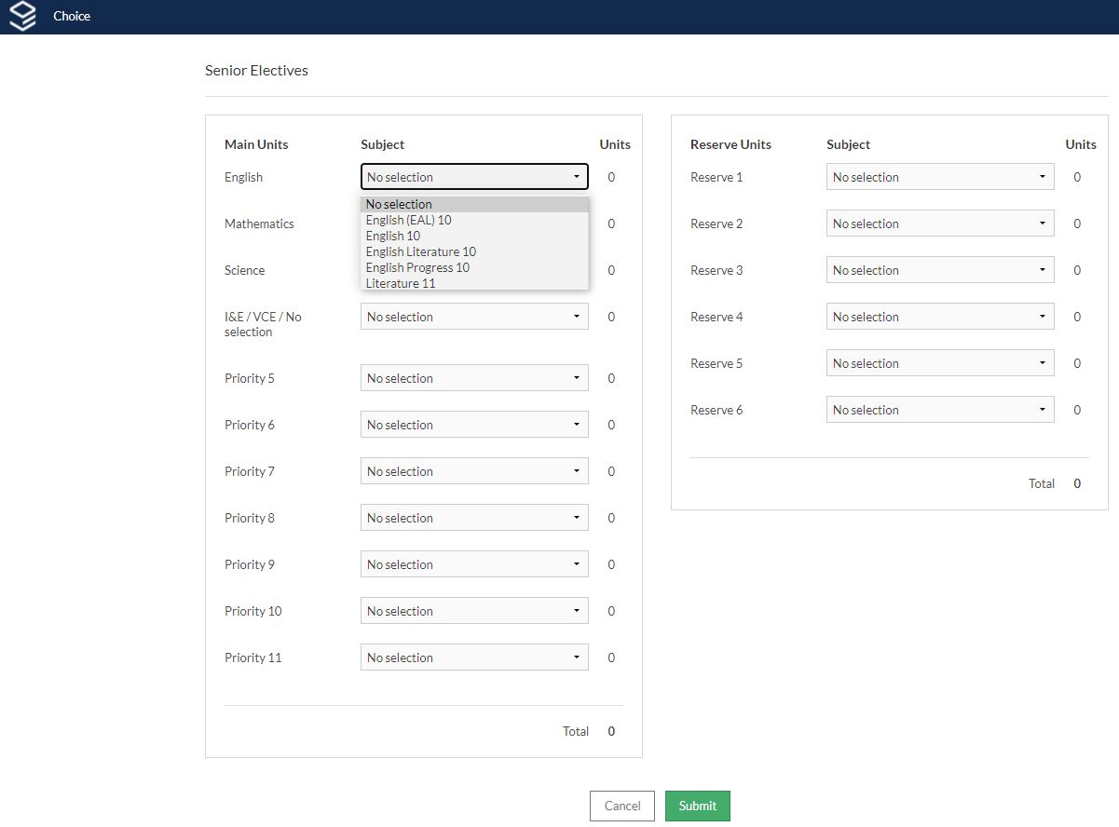
Clicking on the drop down arrows will reveal the subjects you can choose from…
NOTE: Only students in the ACE program may select:
-VCE Literature
AND/OR
-VCE Maths (General Maths or Maths Methods)

Slide 6
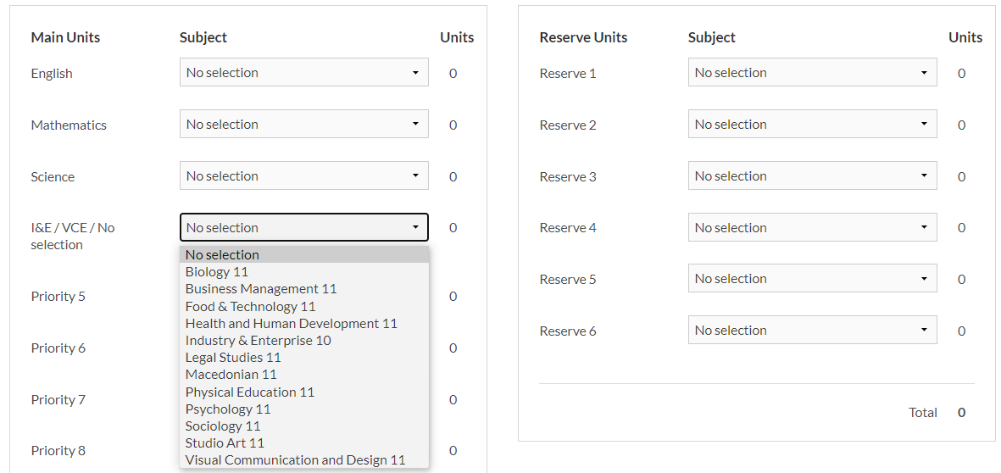

Please select the VCE Subject you have chosen to study. (MUST be approved.)
OR
If you are NOT completing any VCE subject, you must select Industry & Enterprise 10
OR
If you already chose a VCE Mathematics or Literature earlier, leave this as No Selection.
In 2022, Year 11 Subjects on offer for Year 10 students include:
Biology 11
Business Management 11
Food Technology 11
Health and Human Development 11
Legal Studies 11
Physical Education 11
Psychology 11
Sociology 11
Studio Arts 11
Visual Communication & Design 11

Slide 7
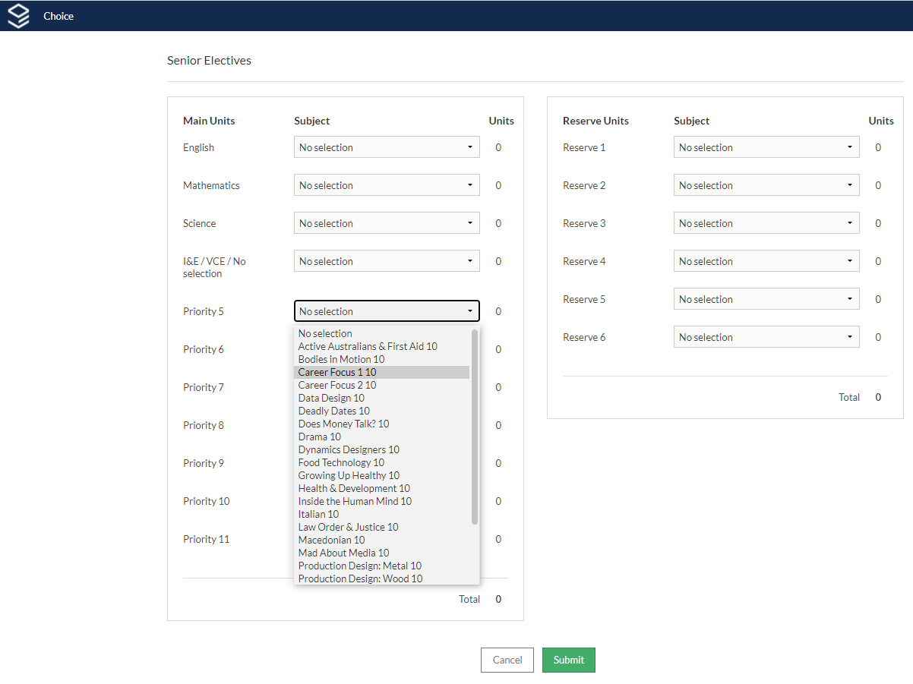
Example of a student choosing to enter the (Career Focus Program)…
MUST pick Career Focus 1 10 as Priority 5
&
Career Focus 2 10 as Priority 6

Slide 8
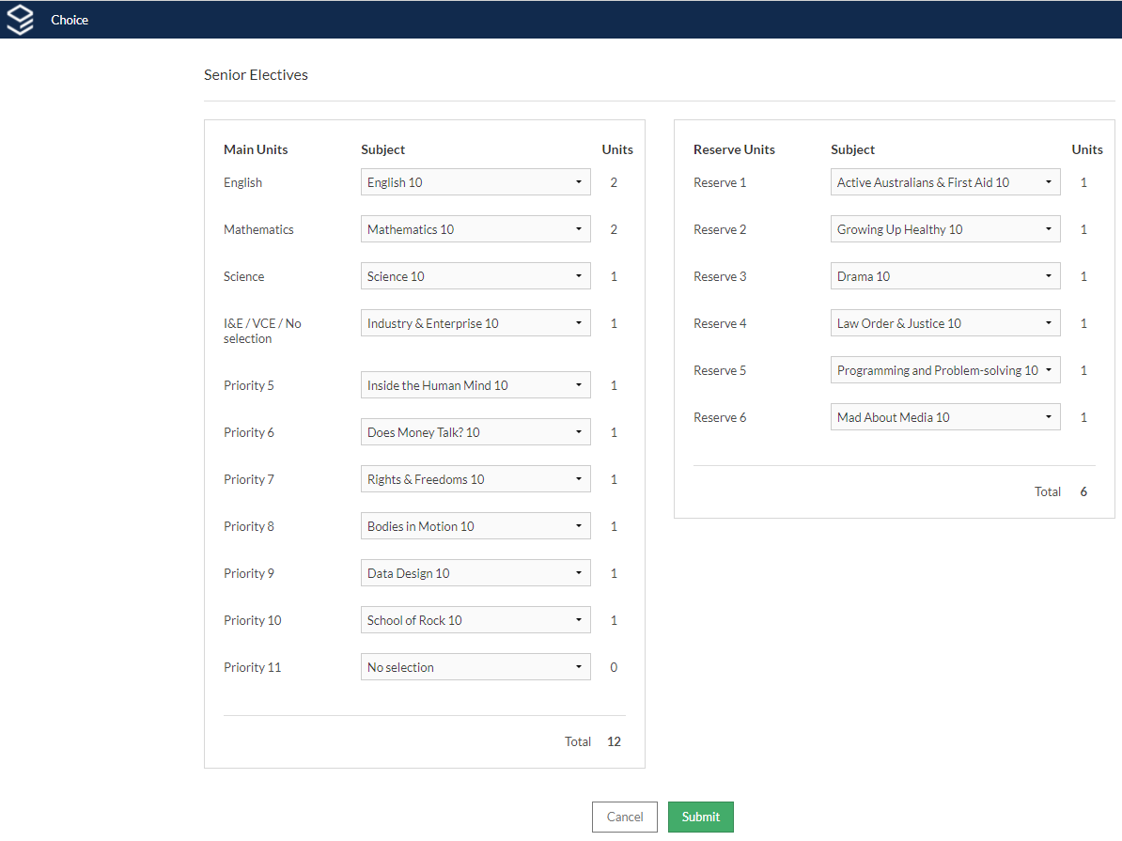
Example of a student choosing subjects.
Yay!
12 Main Units
6 Reserve Units

Slide 9
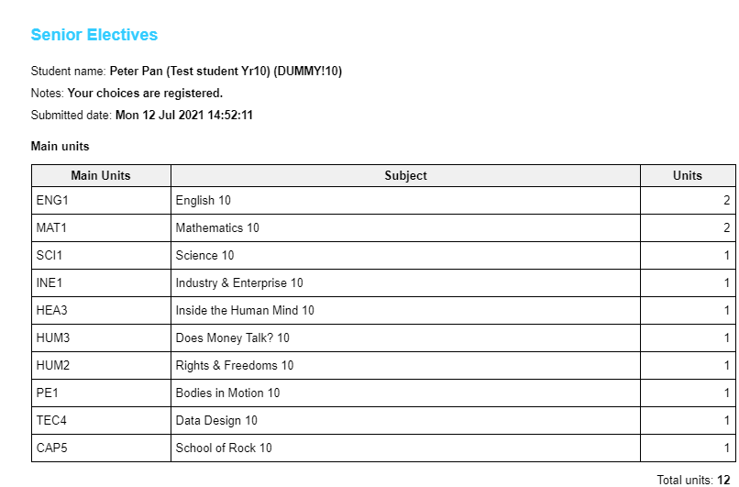
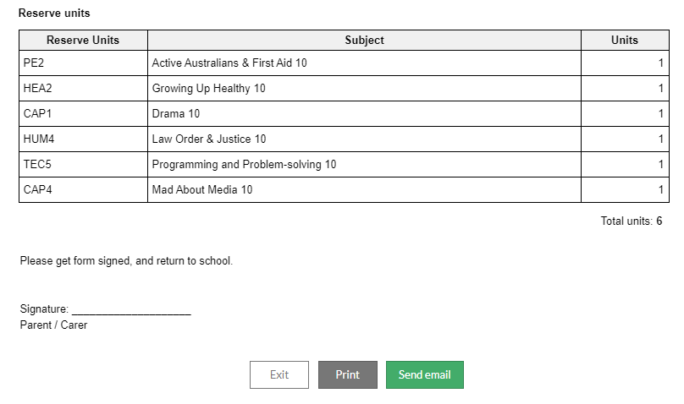
If you have successfully completed the subject selection form, this screen will appear…
-Print your form.
-Get it signed by your parents/carers.
-Return the form to your coordinators.

Slide 10
This form will be used to complete your subject selections
2) This form will be used to complete your SIP subject

Slide 11
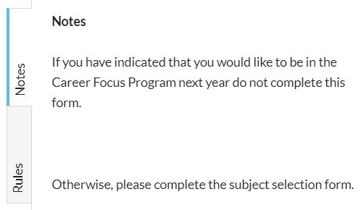

Slide 12
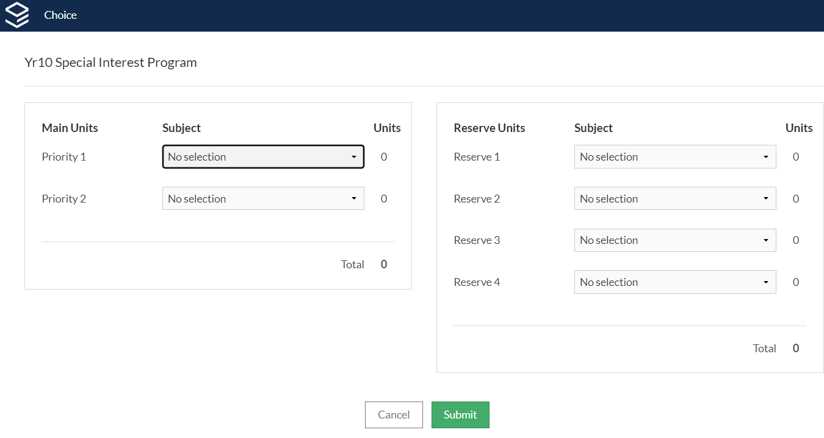

Slide 13
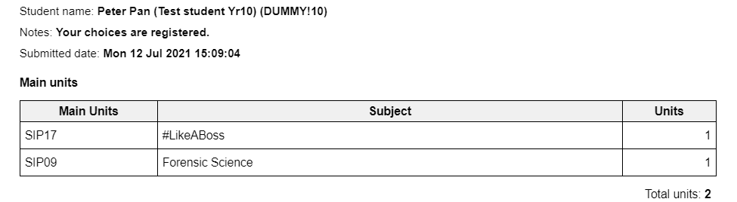
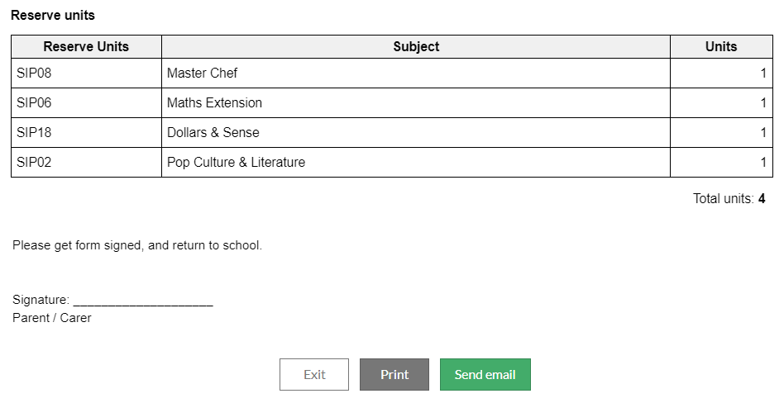
-Print your form.
-Get it signed by your parents/carers.
-Return the form to your coordinators.

