Slide 1


Year 12 Subject Selection Guide
2026

Slide 2
To complete the online subject selection, you will need two things.
1. This link:
https://my.edval.education/login
2. Your unique WebCode (check your edupass email)

Slide 3
How to complete the form…
All students
Priority 1: Select the Program you wish to enrol into: VCE, VM, VPC
Priority 2: Select the English/Literacy subject you would like to enrol into.
VCE
Priority 3, 4, 5, 6: Pick your subjects in order of preference.
Reserve: Pick your reserve subject.
VM/VPC
Priority 3, 4, 5: Select Maths/Numeracy, Work Related Skills, Personal Development Skills.
Priority 6: Pick the Community Elective you want to enrol into.
Reserve: Pick a reserve Community Elective.

Slide 4
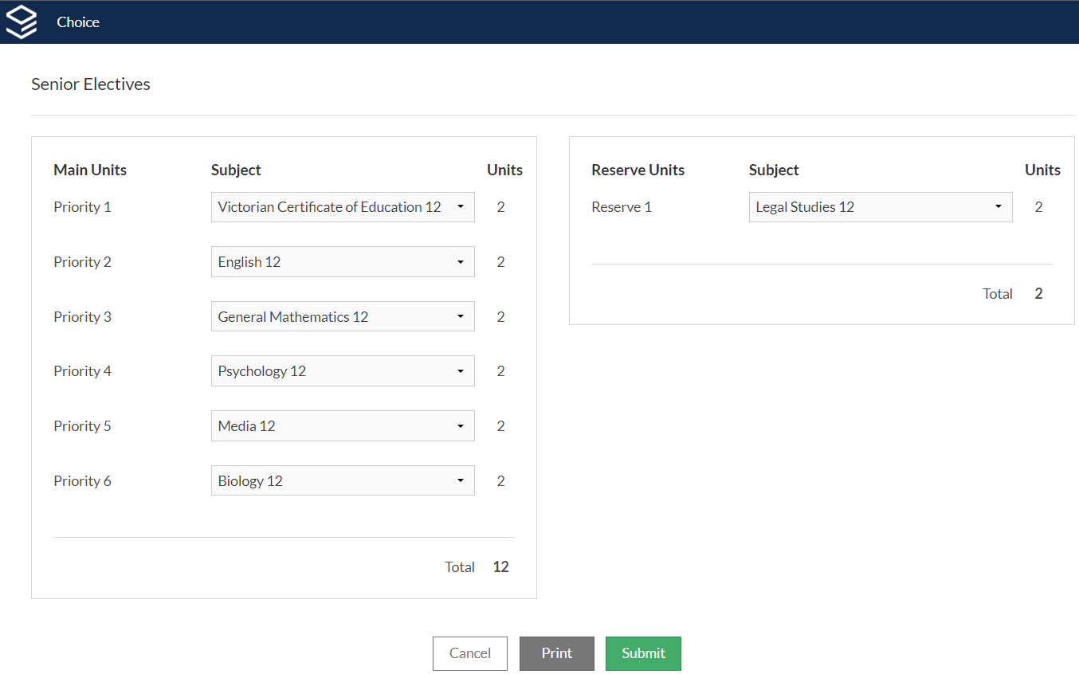
Example: VCE
12 Main Units
2 Reserve Units

Slide 5
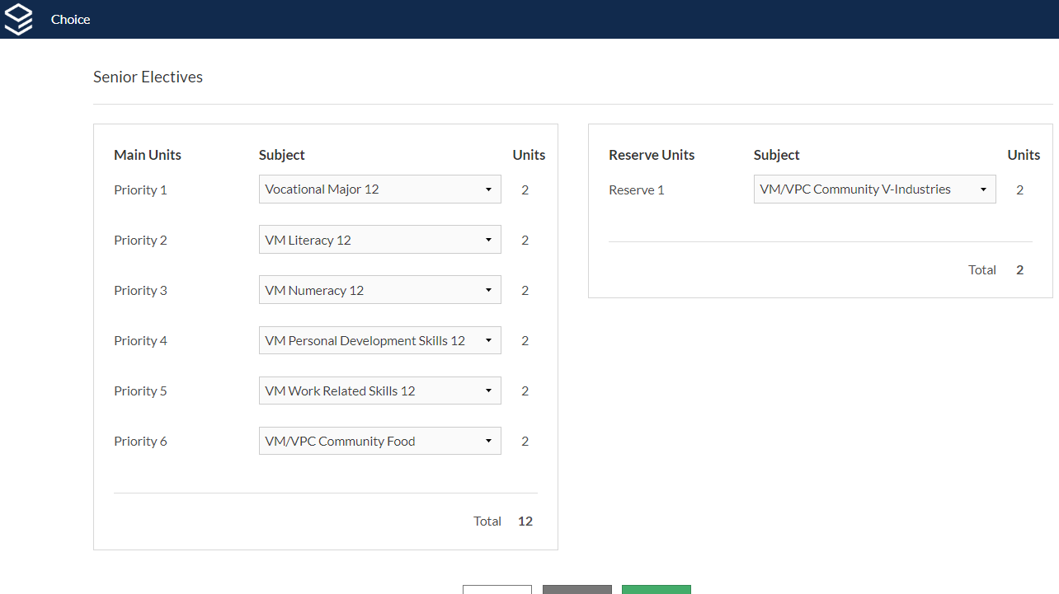
Example: VM
12 Main Units
2 Reserve Units

Slide 6
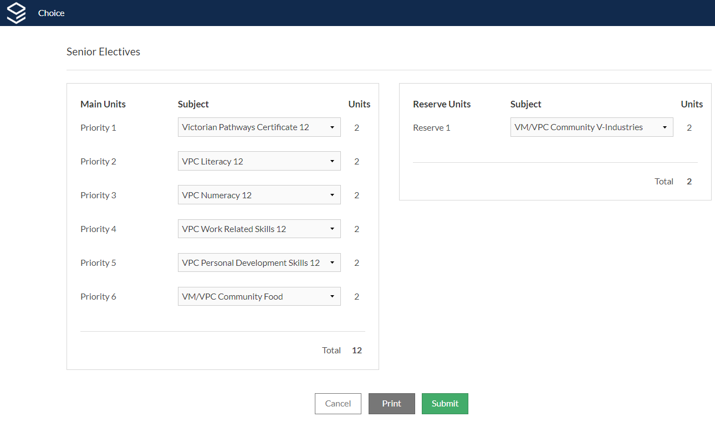
Example: VPC
12 Main Units
2 Reserve Units

Slide 7
Questions you may have…

Slide 8
How do I get my WebCode?
It has been sent to you via
School Email (EduPass)

Slide 9
How do I know if the form was submitted?
As soon as you click submit, your subject selections have been submitted.

Slide 10
What do I do if I want to study a subject that is not offered at ESC?
Pick Virtual School Victoria from the drop-down list.

Slide 11
How do I indicate if I want to do a VET subject?
VM/VPC students: You must do a VET. Organise this with Natalie.

Slide 12
Can I resubmit if I made an error or changed my mind?
Yes.
Just login again and make any adjustments that are needed.
BUT
You won’t be able to make changes after the due date!

Slide 13
When do I have to submit the form by?
Friday 4th July
(form closes @ 3:00pm)

Slide 14
What if I try to submit the form and it just won’t let me?
This can happen…
Simply refresh the page and try and try again.

Slide 15
What if I try to submit the form and it won’t let me?
(I’ve done something wrong, but I just know what.)
This can happen too…
Take a screen shot and send it to Mr Vogdanis via Compass.

Slide 16
Are there any other questions?

Slide 17
Thank you and good luck.

