Slide 1

Year 9 Subject Selection Guide 2026

Slide 2
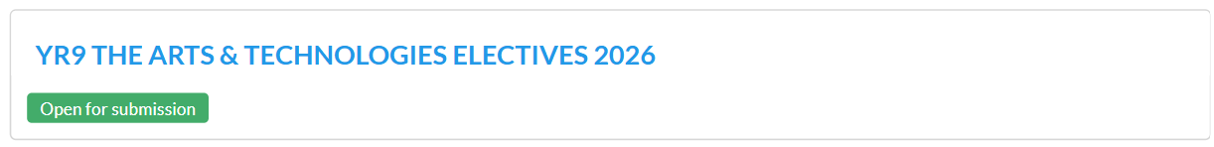
To complete the online subject selection form, you will need two things.
1. This link:
https://my.edval.education/login
2. Your unique WebCode (check your Outlook email)

Slide 3
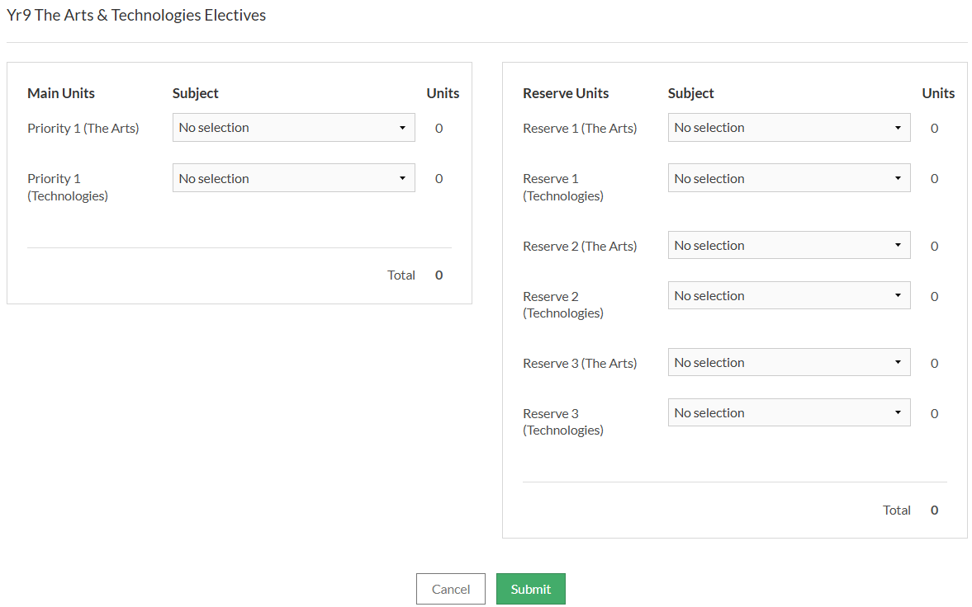

Slide 4
Now… What to pick?
Year 7 -9 Programs and Subjects Handbook
2026

Slide 5
The Arts Electives
Ceramics: Learn to shape clay by hand or on a potter’s wheel, then glaze and fire pieces like bowls and vases.
Drama: Act, direct, design stages, and work on lighting/sound. Study plays from Ancient Greece to modern times.
Media: Analyse and create media like videos, podcasts, and photos. Focus on superheroes and sitcoms.
Music Performance: Pick an instrument, rehearse solo and group pieces, and perform popular music styles.
Printmaking: Try print techniques like linocut, etching, and mono-printing to make unique artwork.
Visual Communication & Design: Draw and design using manual and digital tools. Explore real-world design tasks in environmental, industrial, and communication fields.

Slide 6
Technologies Electives
Furniture Design & Technology: Design and build timber furniture. Learn technical drawing and CAD.
Engineering: Build projects like electric model cars and 3D prints. Learn basic design and circuitry. Bring your laptop.
Food & Technology: Cook using design briefs. Learn about cultures, nutrition, and food presentation.
Digital Communication & Design: Use computers to learn programming, web design, digital media, and networking. Bring your laptop.

Slide 7
Questions you may have…

Slide 8
How do I get my WebCode?
You will receive an email (EduPass) with your unique WebCode.
If you are having difficulties with this, speak to your coordinators.

Slide 9
How do I know if the form was submitted?
As soon as you click submit, your subject selections have been submitted.

Slide 10
Can I resubmit if I made an error or changed my mind?
Yes.
Just login again and make any adjustments that are needed.
BUT
You won’t be able to make changes after the due date!

Slide 11
When do I have to submit the form by?
Thursday 14th August 3:00PM

Slide 12
Are there any other questions?

Slide 13
Thank you and good luck.

