Slide 1
Year 9 Subject Selection Guide 2024

Slide 2
To complete the online subject selection form, you will need two things.
1. This link:
https://my.edval.education/login
2. Your unique WebCode (check your Outlook email)

Slide 4
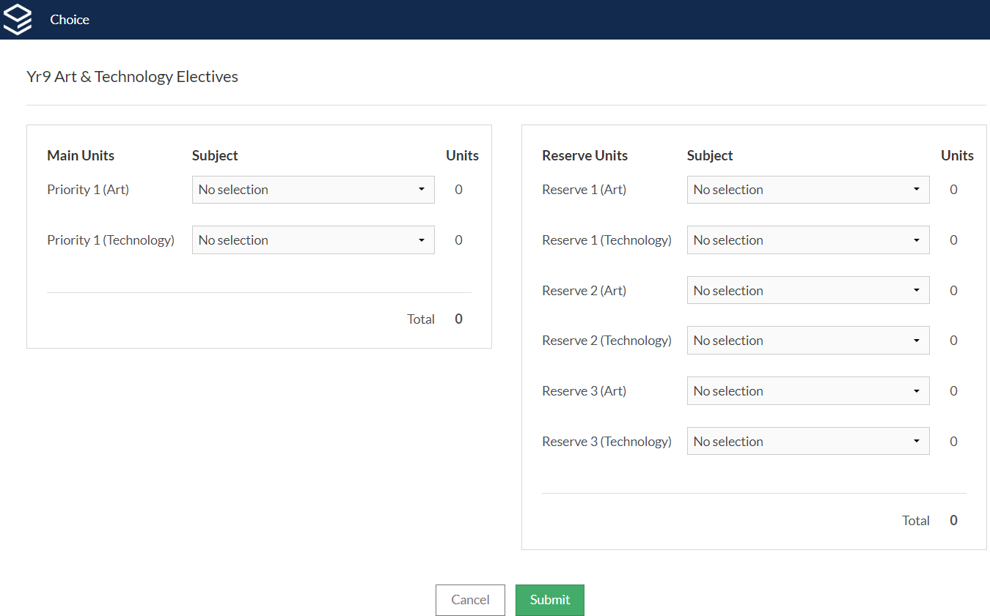
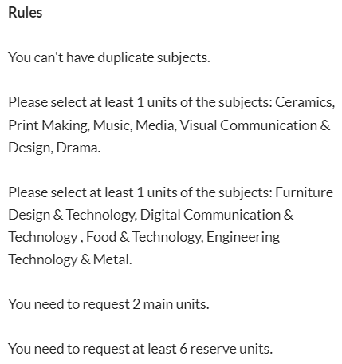

Slide 5
This is the Art Elective you really want to do.
It might run in Semester 1 or Semester 2

Slide 6
This is the Technology Elective you really want to do.
It might run in Semester 1 or Semester 2

Slide 7
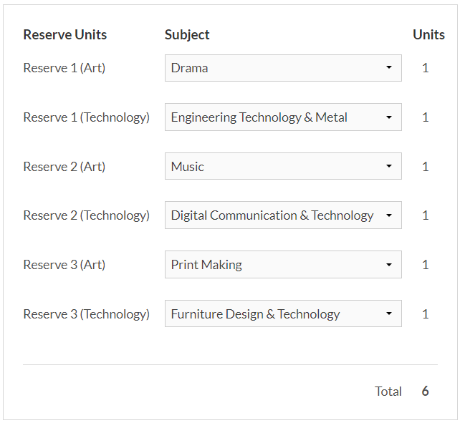
The Reserve subjects are the subjects you wouldn’t mind doing if you didn’t get the Main Units.
Put these in order of preference.

Slide 8
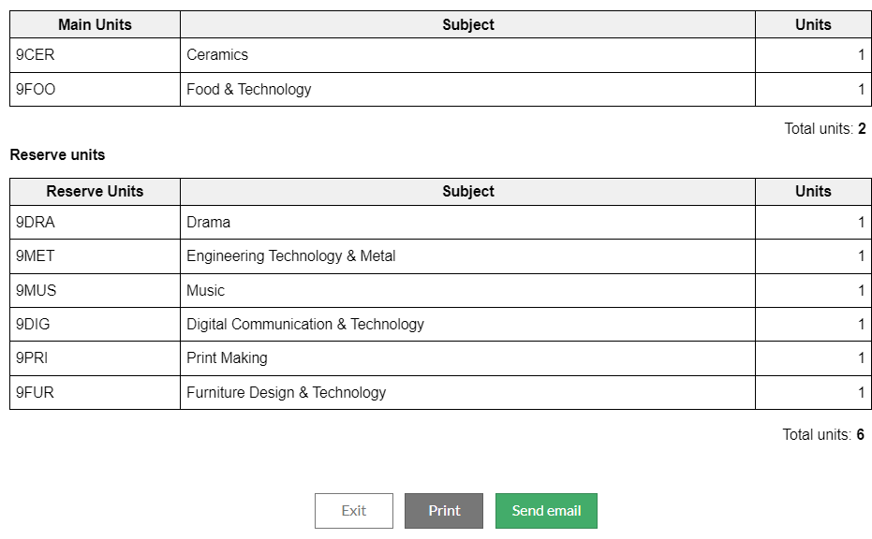
If you have successfully completed the subject selection form, this screen will appear…
-Do not send email.
-Print a copy for yourself (optional)
-Exit.

Slide 9
Now… What to pick???
Check out the school website for the
Year 9 Subject Handbook, 2024.

Slide 10
Questions you may have…

Slide 11
How do I get my WebCode?
You will receive an email (EduPass) with your unique WebCode.
If you are having difficulties with this, speak to your coordinators.

Slide 12
How do I know if the form was submitted?
As soon as you click submit, your subject selections have been submitted.

Slide 13
Can I resubmit if I made an error or changed my mind?
Yes.
Just login again and make any adjustments that are needed.
BUT
You won’t be able to make changes after the due date!

Slide 14
When do I have to submit the form by?
Thursday 7th September

Slide 15
What if I try to submit the form and it just won’t let me?
(Doesn’t even give me a reason!!!)
This can happen…
Simply refresh the page and try and try again.

Slide 16
Are there any other questions?
XUNO message me: Mr Vogdanis

Slide 17
Thank you and good luck.

